Slide 1


Name: Carlo Martínez Date: 16 June 2025

Slide 2
Outline
Executive Summary
Introduction
Methodology
Results
Conclusion

Slide 3
Executive Summary
Summary of Methodologies
Data Collection: Accessed SpaceX launch data via API and web scraped records from Wikipedia.
Data Cleaning & Preparation:
Cleaned and formatted the data.
Stored data in Db2 database and performed SQL queries.
Conducted exploratory data analysis.
Feature Engineering: Created new features and standardized the data.
Interactive Visualizations:
Mapped launch sites and success rates using Folium.
Built an interactive dashboard with Plotly Dash.
Model Building & Evaluation:
Implemented SVM, Decision Trees, and K-Nearest Neighbors.
Tuned hyperparameters with GridSearchCV.
Evaluated models using test data accuracy.
Summary of Results
1. Data Insights:
Identified factors influencing Falcon 9 first stage landings.
Visualized geographical patterns and success rates.
SVM and K-Nearest Neighbors: 83.33% accuracy.
Decision Tree: 94.44% accuracy.
Launch site and payload mass impact landing success.
Decision Tree model is the most effective predictor.
2. Model Performance:
3. Key Findings:

Slide 4
Introduction
Project Background and Context:
In this capstone project, we aim to predict the successful landing of the Falcon 9 first stage. SpaceX advertises rocket launches at a significantly lower cost compared to other providers, largely due to their ability to reuse the first stage of the rocket. By accurately predicting landing success, we can estimate launch costs and provide valuable insights for companies bidding against SpaceX.
Problems We Want to Find Answers To:
What factors influence the successful landing of the Falcon 9 first stage?
How can we accurately predict the landing outcome using machine learning models?
Which machine learning model performs best in predicting the landing success?

Slide 5

Section 1
5

Slide 6
Methodology
Executive Summary: This project employs a comprehensive approach to predict the successful landing of the Falcon 9 first stage, incorporating data collection, processing, exploratory analysis, interactive visualizations, and predictive modeling.
Data Collection Methodology: Data was sourced from the SpaceX API, which provided detailed records of Falcon 9 launches, including launch dates, sites, payloads, and outcomes.
Perform Data Wrangling: Data cleaning involved handling missing values, standardizing formats, and ensuring consistency. Key features were extracted and new features engineered to enrich the dataset.
Perform Exploratory Data Analysis (EDA) Using Visualization and SQL:
Visualized launch success rates, payloads, and launch sites using Matplotlib and Seaborn.
Executed SQL queries to derive insights and answer specific questions regarding the dataset.

Slide 7
Methodology
Perform Interactive Visual Analytics Using Folium and Plotly Dash:
Used Folium to create interactive maps displaying launch sites and outcomes.
Developed a Plotly Dash application with interactive components like dropdowns and sliders to analyze launch success rates and payload ranges.
Perform Predictive Analysis Using Classification Models:
Built and evaluated various classification models including Logistic Regression, SVM, KNN, and Decision Trees.
Employed GridSearchCV for hyperparameter tuning.
Evaluated models based on accuracy, and identified the best performing model for predicting landing success.
Github URL: https://github.com/srinibas-masanta/IBM-Applied-Data-Science-Capstone.git

Slide 8
Data Collection
Step 1: SpaceX API Request
Initiate API Request
Fetch Launch Data
Store Data Locally
Step 2: Web Scraping Wikipedia
Extract HTML Table
Parse with BeautifulSoup
Convert to DataFrame
Step 3: Data Integration
SpaceX API
Data & Wikipedia
Data
Final Integrated
Data
Merge Datasets

Slide 9
Data Collection – SpaceX API
Step 1: Initiate API Request
Use Python's `requests` library to connect to the SpaceX API.
Endpoint: `https://api.spacexdata.com/v4/launches`
Fetch Launch Data (launch dates, sites, payloads, outcomes, etc.)
Initiate API Request (requests.get)
Step 2: Parse API Response
Convert API response from JSON to a Python
dictionary.
Extract relevant fields: launch date, launch site,
payload mass, rocket type, outcome.
Extract Relevant Fields (date, site,
payload, rocket, outcome)
Parse JSON
Response (response.json())
Step 3: Store Data Locally
Save extracted data into a pandas DataFrame.
Store the DataFrame locally for further processing.
Store Data in
DataFrame (pandas.DataFrame)
Save Data Locally (data.csv or
database)
GitHub URL: 1. jupyter-labs-spacex-data-collection-api.ipynb

Slide 10
Data Collection - Scraping
Step 1: Initiate Web Scraping
Use Python's `requests` library to fetch the HTML content of the Wikipedia page.
Target URL:
`https://en.wikipedia.org/wiki/List_of_Falcon_9_ and_Falcon_Heavy_launches`
Step 2: Parse HTML Content
Use `BeautifulSoup` to parse the HTML content.
Extract the HTML table containing Falcon 9 launch records.
Step 3: Convert to DataFrame
Convert the extracted HTML table into a pandas DataFrame.
Clean and format the DataFrame, ensuring data consistency.
Request Web
Page (requests.get)
Parse HTML Content
(BeautifulSoup)
Convert HTML Table to DataFrame (pandas.DataFrame)
Extract Launch Records (HTML table)
Clean and Format Data (drop nulls,
standardize columns)
GitHub URL: 2. jupyter-labs-webscraping.ipynb

Slide 11
Data Wrangling
Overview: Data wrangling involves cleaning, transforming, and organizing raw data into a structured format suitable for analysis.
Step 1: Data Cleaning
Identify and fill or remove missing values in the dataset.
Use appropriate imputation techniques or drop rows/columns with excessive missing data.
Step 2: Data Transformation
Convert data types to appropriate formats (e.g., date-time, numerical).
Standardize text (e.g., lowercase, remove whitespace).
Create new features from existing data (e.g., extract year from date).
Normalize/scale numerical features to ensure consistency.

Slide 12
Data Wrangling
Step 3: Data Integration
Merge datasets collected from different sources (API, web scraping) into a single cohesive dataset.
Ensure consistent column names and data formats across datasets.
Step 4: Data Validation
Check for duplicate records and remove them.
Verify the accuracy and consistency of data entries.
GitHub URL: 3. labs-jupyter-spacex-Data wrangling.ipynb

Slide 13
Data Wrangling Flowchart
Identify Missing
Values (pandas.isnull)
Ensure Consistency (align columns, data types)
Check for Duplicates (pd.duplicated, drop)
Impute/Remove Missing Data (fillna/dropna)
Merge DataFrames (pd.merge, pd.concat)
Verify Data
Accuracy
(consistency checks)
Convert Data Types (pd.to_datetime, astype)
Normalize/Scale Features (MinMaxScaler, StandardScaler)
Standardize Text
(str.lower, strip)
Feature Engineering (create new columns)

Slide 14
EDA with Data Visualization
Overview:
Exploratory Data Analysis (EDA) involves visually exploring and summarizing the main characteristics of a dataset. The goal is to understand the data's distribution, identify patterns, and uncover relationships between variables.
Charts Plotted:
Histograms:
Purpose: Used to visualize the distribution of numerical variables such as launch success rates, payload mass, and flight number.
Why: Helps in understanding the spread and central tendency of the data, identifying outliers, and assessing data skewness.
Bar Charts:
Purpose: Used to compare categorical variables such as launch outcomes (success/failure) across different categories like launch sites or rocket types.
Why: Provides a clear comparison of frequencies or proportions within categorical data, highlighting patterns or trends.
Line Charts:
Purpose: Used to track trends over time, such as the success rate of Falcon 9 launches across different years.
Why: Reveals temporal patterns and helps in understanding performance trends or changes over specific periods.

Slide 15
EDA with Data Visualization
Scatter Plots:
Purpose: Used to explore relationships between two numerical variables, such as payload mass vs. launch success.
Why: Identifies correlations or dependencies between variables, visualizing how one variable changes concerning another.
Heatmaps:
Purpose: Used to visualize correlation matrices between multiple numerical variables.
Why: Helps in identifying strong correlations (positive or negative) between variables, aiding feature selection or understanding multicollinearity.
Box Plots:
Purpose: Used to display the distribution of numerical data through their quartiles.
Why: Visualizes the spread and skewness of data, highlighting outliers and comparing distributions across different categories.
Github URL: 5. jupyter-labs-eda-dataviz.ipynb

Slide 16
EDA with SQL
Aggregate Queries:
Calculated total number of launches.
Counted successful and failed launches.
Calculated success rates by launch site and rocket type.
Join Queries:
Joined tables to link launch records with additional data (e.g.,
rocket details).
Combined datasets for comprehensive analysis.
Filtering Queries:
Filtered data to focus on specific launch outcomes (success/failure).
Applied conditions to extract launches based on criteria like launch date or rocket configuration.
Sorting Queries:
Sorted data to identify trends or outliers.
Ordered launches by date or success rate for analysis.
Subqueries:
Nested queries to calculate derived metrics (e.g., average payload mass per launch site).
Subqueries used to perform detailed analysis within larger datasets.
GitHub URL: 4. jupyter-labs-eda-sql-coursera_sqllite.ipynb

Slide 17
Build an Interactive Map with Folium
Map Objects Created
Markers:
Placed markers to indicate launch sites on the map.
Each marker represents a specific geographical location where SpaceX launches have occurred.
Circles:
Added circles around launch sites to visually represent proximity zones.
Circles help visualize the areas around launch sites that might influence operational decisions.
Lines:
Drew lines to connect launch sites with their proximities or other relevant locations.
Lines provide spatial context and connections between
different points of interest related to launches.
Reasons for Adding Objects
To pinpoint exact launch locations for spatial reference.
Helps users identify where SpaceX has conducted launches geographically.
Illustrates the potential impact zones around launch sites.
Provides a visual representation of safety perimeters or operational boundaries.
Shows connections or relationships between launch sites and relevant features.
Enhances understanding of spatial relationships and dependencies.
Markers:
Circles:
Lines:
Github URL: 6. lab_jupyter_launch_site_location.ipynb

Slide 18
Build a Dashboard with Plotly Dash
Plots/Graphs Added
Success Pie Chart:
Displays the distribution of successful and failed launches.
Helps visualize the overall success rate and performance trends.
Success-Payload Scatter Plot:
Shows the relationship between payload mass and launch success.
Allows users to explore how payload mass influences mission outcomes.
Github URL: spacex_dash_app.py
Interactions Added
Launch Site Dropdown:
Enables users to select specific launch sites for analysis.
Facilitates filtering and focused exploration based on geographical locations.
Range Slider for Payload:
Allows users to adjust payload mass ranges
dynamically.
Offers flexibility in examining launch success concerning payload mass variations.

Slide 19
Reasons for Adding Plots and Interactions
Success Pie Chart:
Provides a quick overview of mission success rates.
Essential for stakeholders to understand overall performance metrics at a glance.
Success-Payload Scatter Plot:
Helps identify correlations between payload characteristics and launch outcomes.
Supports decision-making processes related to payload planning and operational strategies.
Launch Site Dropdown:
Enhances user experience by focusing analysis on specific launch locations.
Allows for regional insights and comparisons across different launch sites.
Range Slider for Payload:
Offers interactive exploration of how payload mass affects mission success.
Enables detailed analysis and insights into payload-related performance factors.

Slide 20
Predictive Analysis (Classification)
Data Preprocessing:
Standardized features to ensure all variables contribute equally.
Split data into training and test sets for model validation.
Model Selection:
Explored multiple classification algorithms: SVM, Decision Trees, and K-Nearest Neighbors (KNN).
Chose algorithms suitable for binary classification tasks based on project requirements.
Hyperparameter Tuning:
Used GridSearchCV to systematically search for optimal hyperparameters.
Tuned parameters such as C (SVM), max_depth (Decision Trees), and n_neighbors (KNN).
Github URL:7. SpaceX_Machine_Learning_Prediction_Part_5.jupyterlite.ipynb
4. Model Evaluation:
Evaluated models using cross-validation techniques to ensure robustness and generalizability.
Utilized metrics like accuracy, precision, recall, and F1-score to assess model performance.
Improvement Iterations:
Iteratively adjusted models based on insights from validation results.
Fine-tuned hyperparameters to maximize predictive accuracy and reliability.
Selection of Best Performing Model:
Identified the model with the highest accuracy on the test set as the best performer.
Considered both training and test set performance to avoid overfitting and ensure real-world applicability.

Slide 21
Predictive Analysis (Flowchart)
Data Preprocessing
Best Performing Model
Model
Selection
Improvement
Iterations
Hyperparameter
Tuning
Model
Evaluation

Slide 22
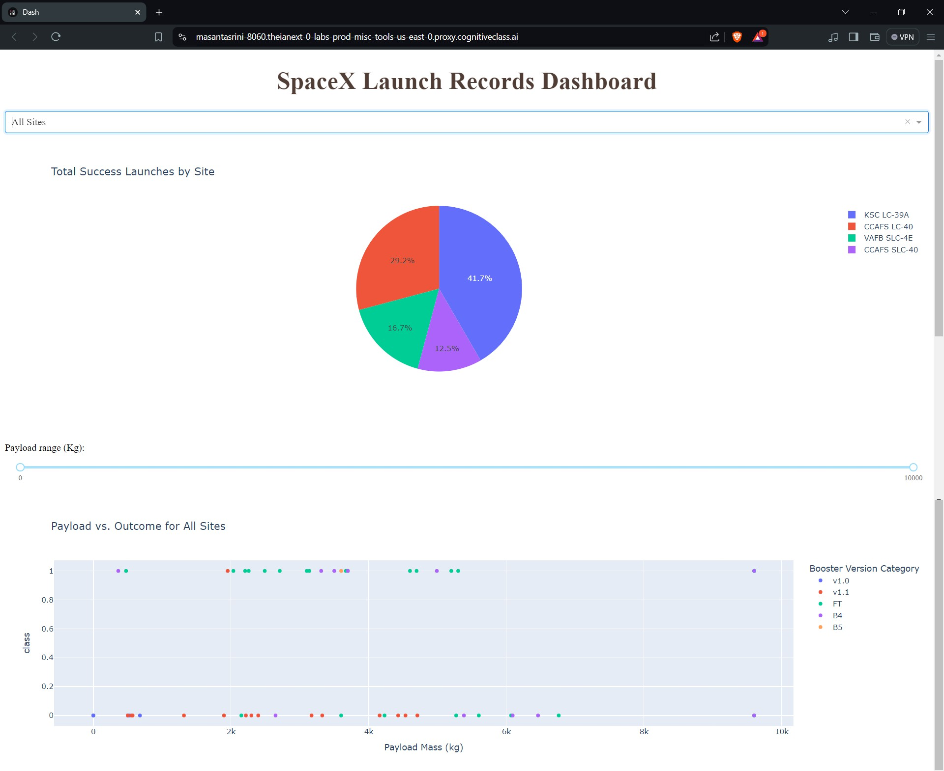
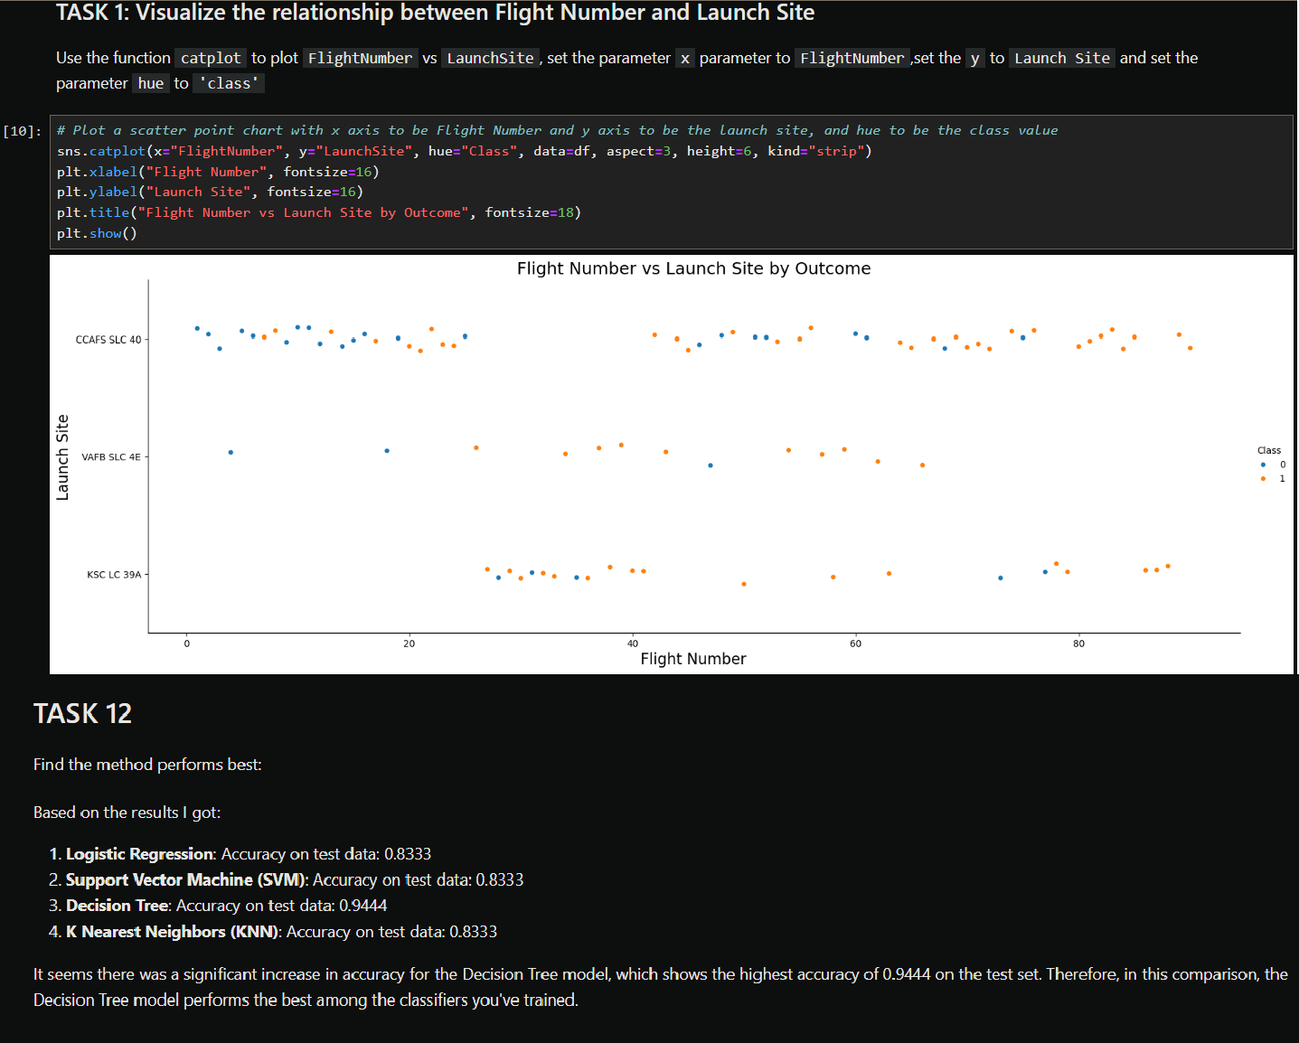

Exploratory data analysis results
Interactive analytics demo in screenshots
Predictive analysis results
Results
22

Slide 23

Section 2

Slide 24
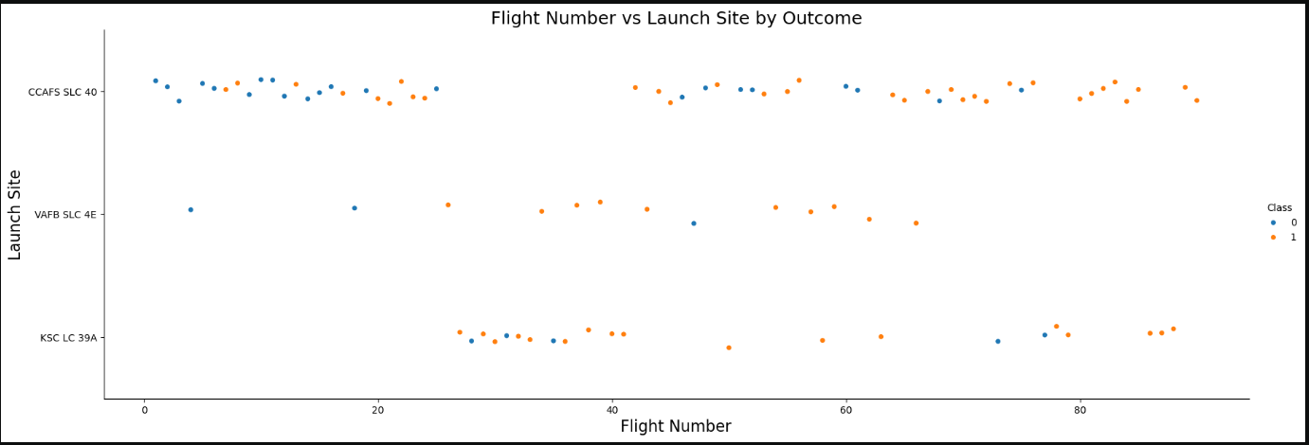
Mixed Outcomes at Major Launch Sites: Both CCAFS SLC 40 and KSC LC 39A have a mix of successful (orange) and unsuccessful (blue) landings, indicating that factors other than the launch site itself may influence the landing success.
Flight Number vs. Launch Site
Consistent Activity Across Flight Numbers: Launches are spread across a wide range of flight numbers at all sites, suggesting consistent activity over time without a clear trend of increasing or decreasing landing success.
24

Slide 25
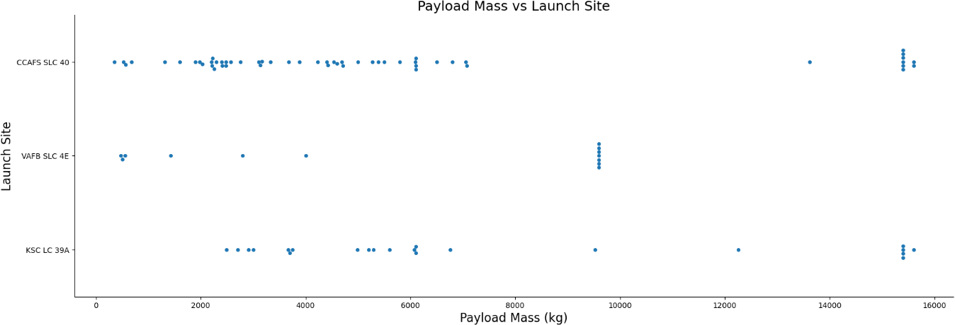
Payload vs. Launch Site
Payload Distribution: Most launches from the CCAFS SLC 40 site handle payloads below 10,000 kg, while the VAFB SLC 4E and KSC LC 39A sites have a wider range of payload masses, indicating varied mission profiles.
High-Capacity Launches: The KSC LC 39A site is frequently used for launching heavier payloads, with multiple launches carrying over 15,000 kg, suggesting its suitability for high-capacity missions.
25

Slide 26
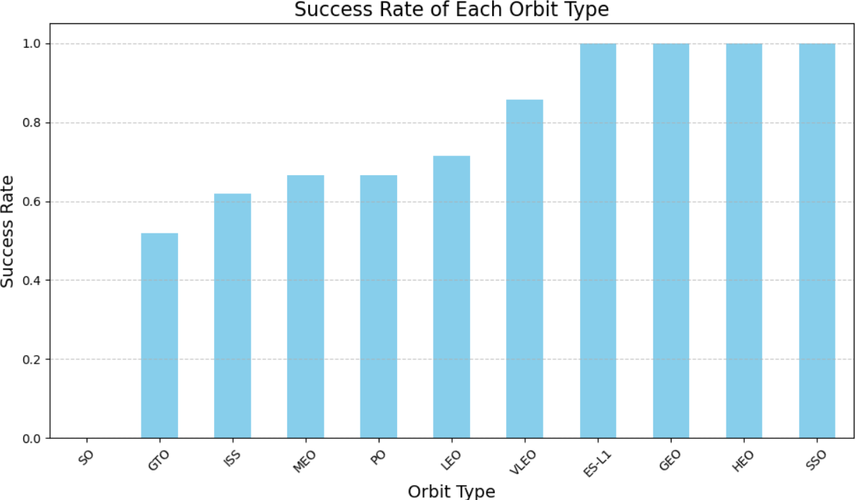
Success Rate vs. Orbit Type
High Success Rates: Missions to VLEO, ES-L1, GEO, HEO, and SSO
orbits have achieved a perfect
success rate, indicating these orbits are highly reliable for successful first stage landings.
Lower Success Rate for GTO: The GTO orbit type shows a significantly lower success rate compared to other orbit types, suggesting that missions to this orbit may involve greater challenges or complexities.
26

Slide 27
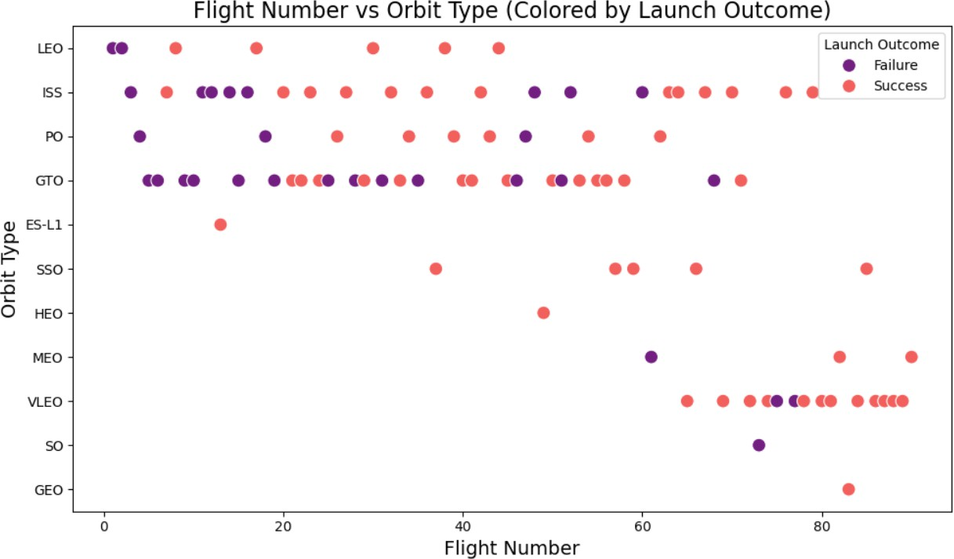
Flight Number vs. Orbit Type
Increased Success Over Time: The success rate of Falcon 9 launches improves significantly with higher flight numbers, indicating that experience and iterative improvements contribute to better outcomes.
Orbit-Specific Performance: Early flights to GTO and ISS orbits had mixed outcomes, but recent missions to these orbits show a higher success rate, reflecting advancements in mission planning and execution.
27

Slide 28
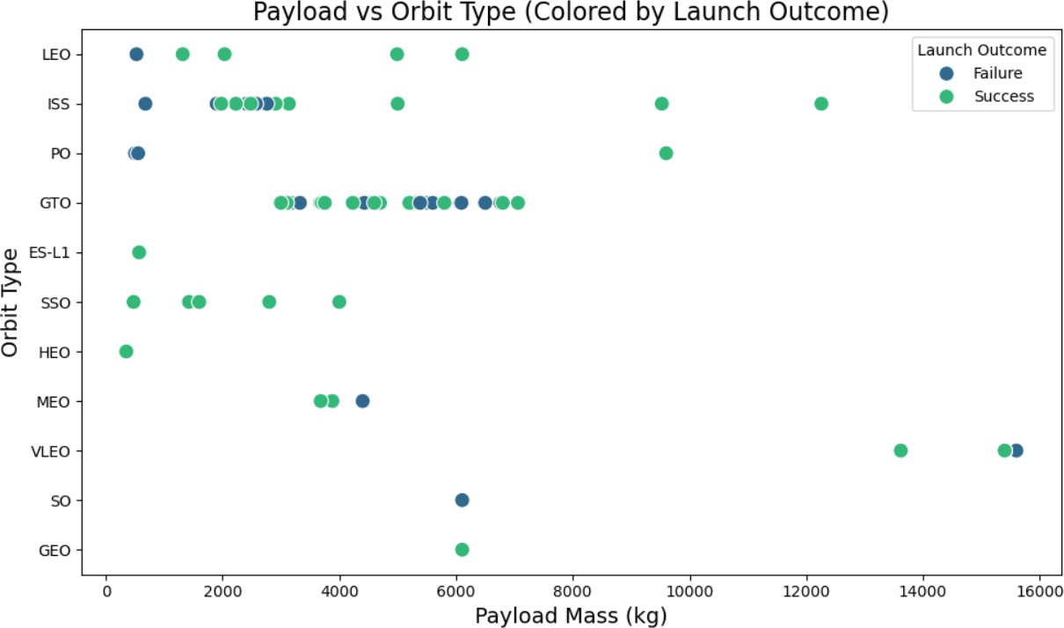
Payload vs. Orbit Type
Successful landings are more frequent across all orbit types, especially for payloads less than 6000 kg.
Higher payload masses (above 10,000 kg) show a mix of successes and failures, indicating increased difficulty with heavier payloads.
28

Slide 29
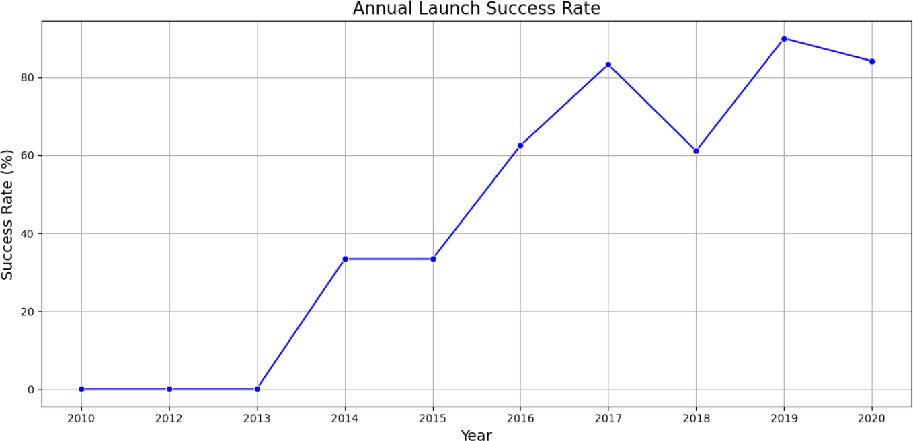
Launch Success Yearly Trend
The annual launch success rate has shown a significant improvement from 2013 onwards, reaching over 80% by 2020.
Despite a dip in 2018, the overall trend indicates increasing reliability and success in Falcon 9 launches over the years.
29

Slide 30
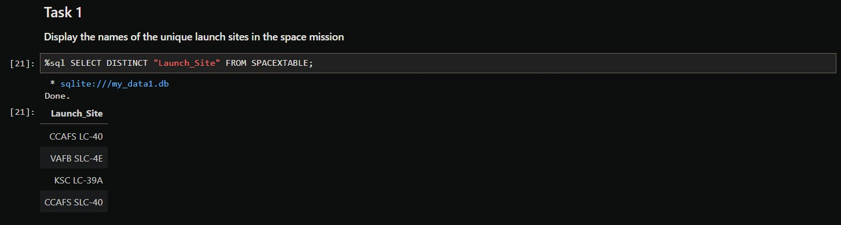
All Launch Site Names

Slide 31
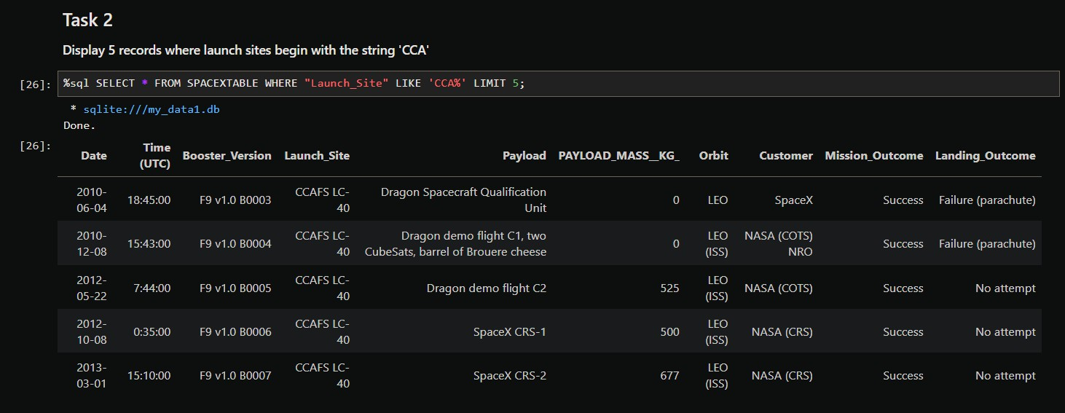
Launch Site Names Begin with 'CCA'

Slide 32
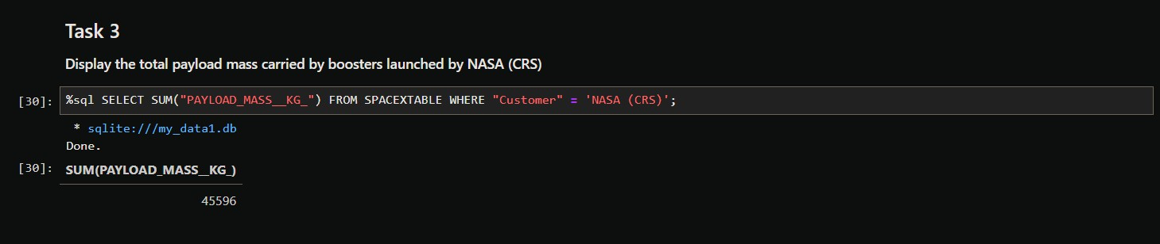
Total Payload Mass

Slide 33
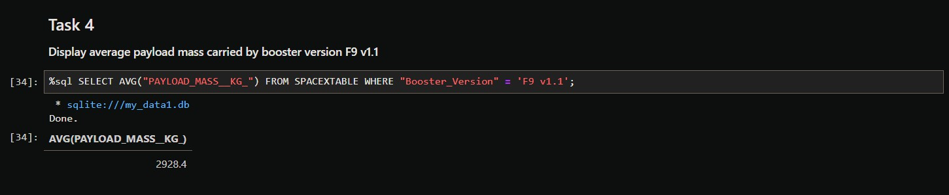
Average Payload Mass by F9 v1.1

Slide 34
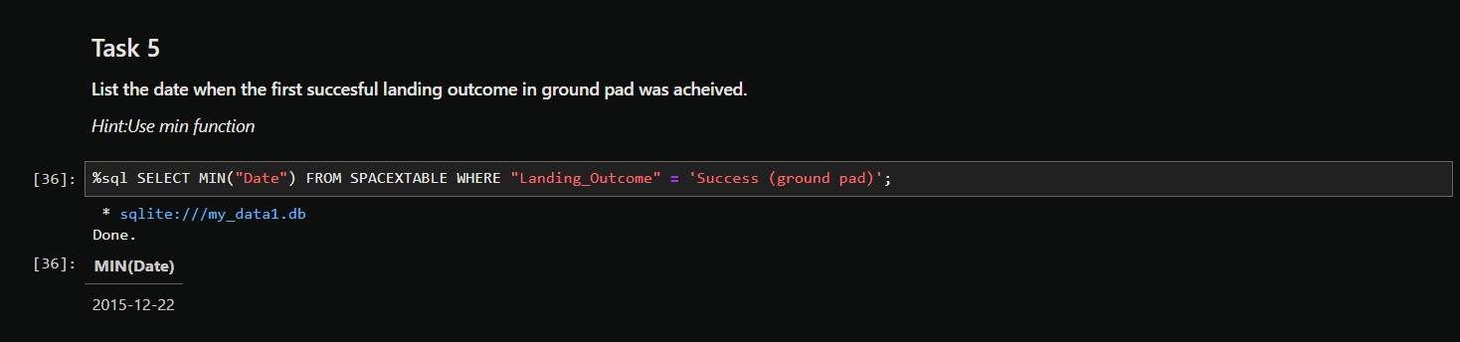
First Successful Ground Landing Date

Slide 35
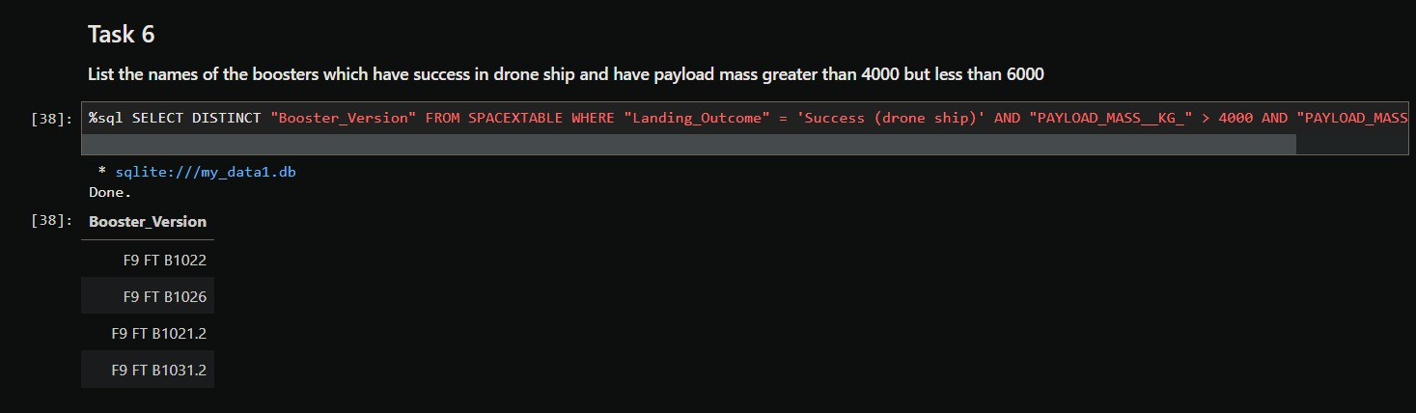
Successful Drone Ship Landing with Payload between 4000 and 6000

Slide 36
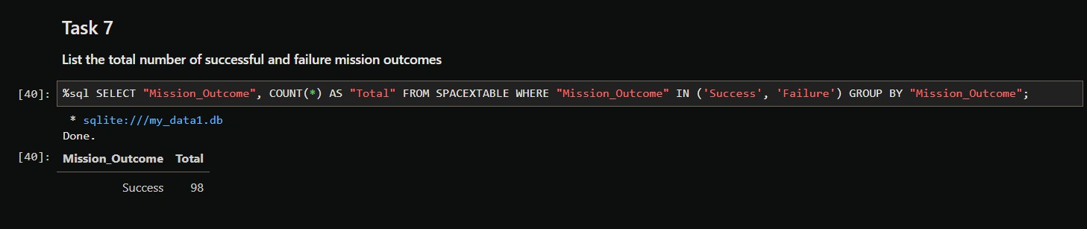
Total Number of Successful and Failure Mission Outcomes

Slide 37
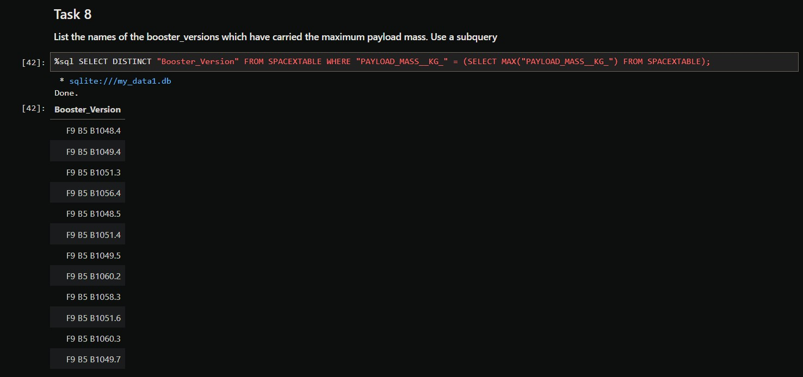
Boosters Carried Maximum Payload

Slide 38
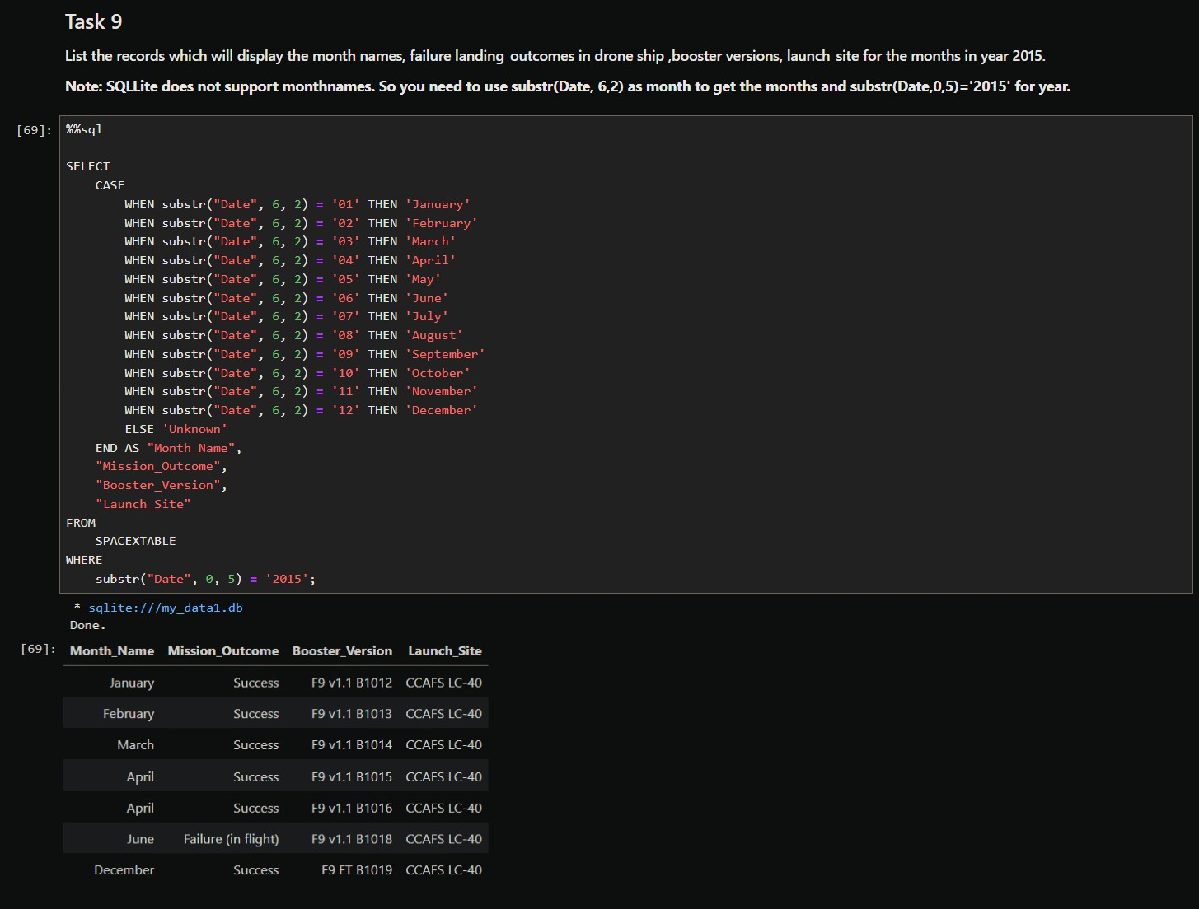
2015 Launch Records

Slide 39
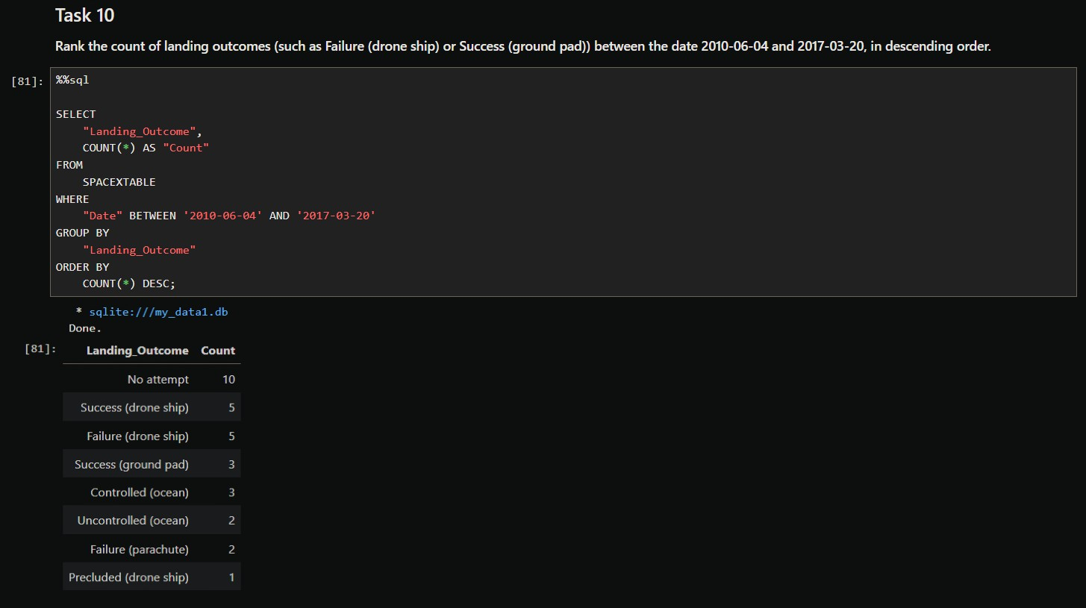
Rank Landing Outcomes Between 2010-06-04 and 2017-03-20

Slide 40

Section 3

Slide 41
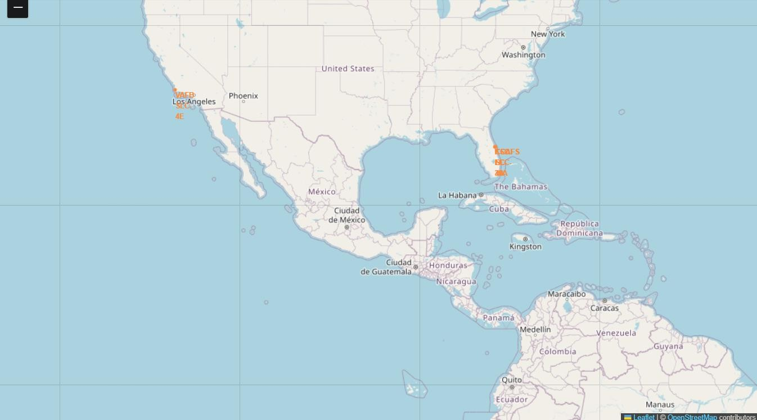
Task 1: Mark all launch sites on a map
Are all launch sites in proximity to the Equator line?
No, not all launch sites are in close proximity to the Equator.
The launch site at Vandenberg Air Force Base (VAFB SLC- 4E) is located at a latitude of 34.63, which is further from the Equator compared to the other sites in Florida.
Are all launch sites in very close proximity to the coast?
Yes, all launch sites are in close proximity to the coast.
The Cape Canaveral sites (CCAFS LC-40 and CCAFS SLC-40) and Kennedy Space Center (KSC LC-39A) are near the coast in Florida.
Vandenberg Air Force Base (VAFB SLC-4E) is also near the coast in California.
41

Slide 42
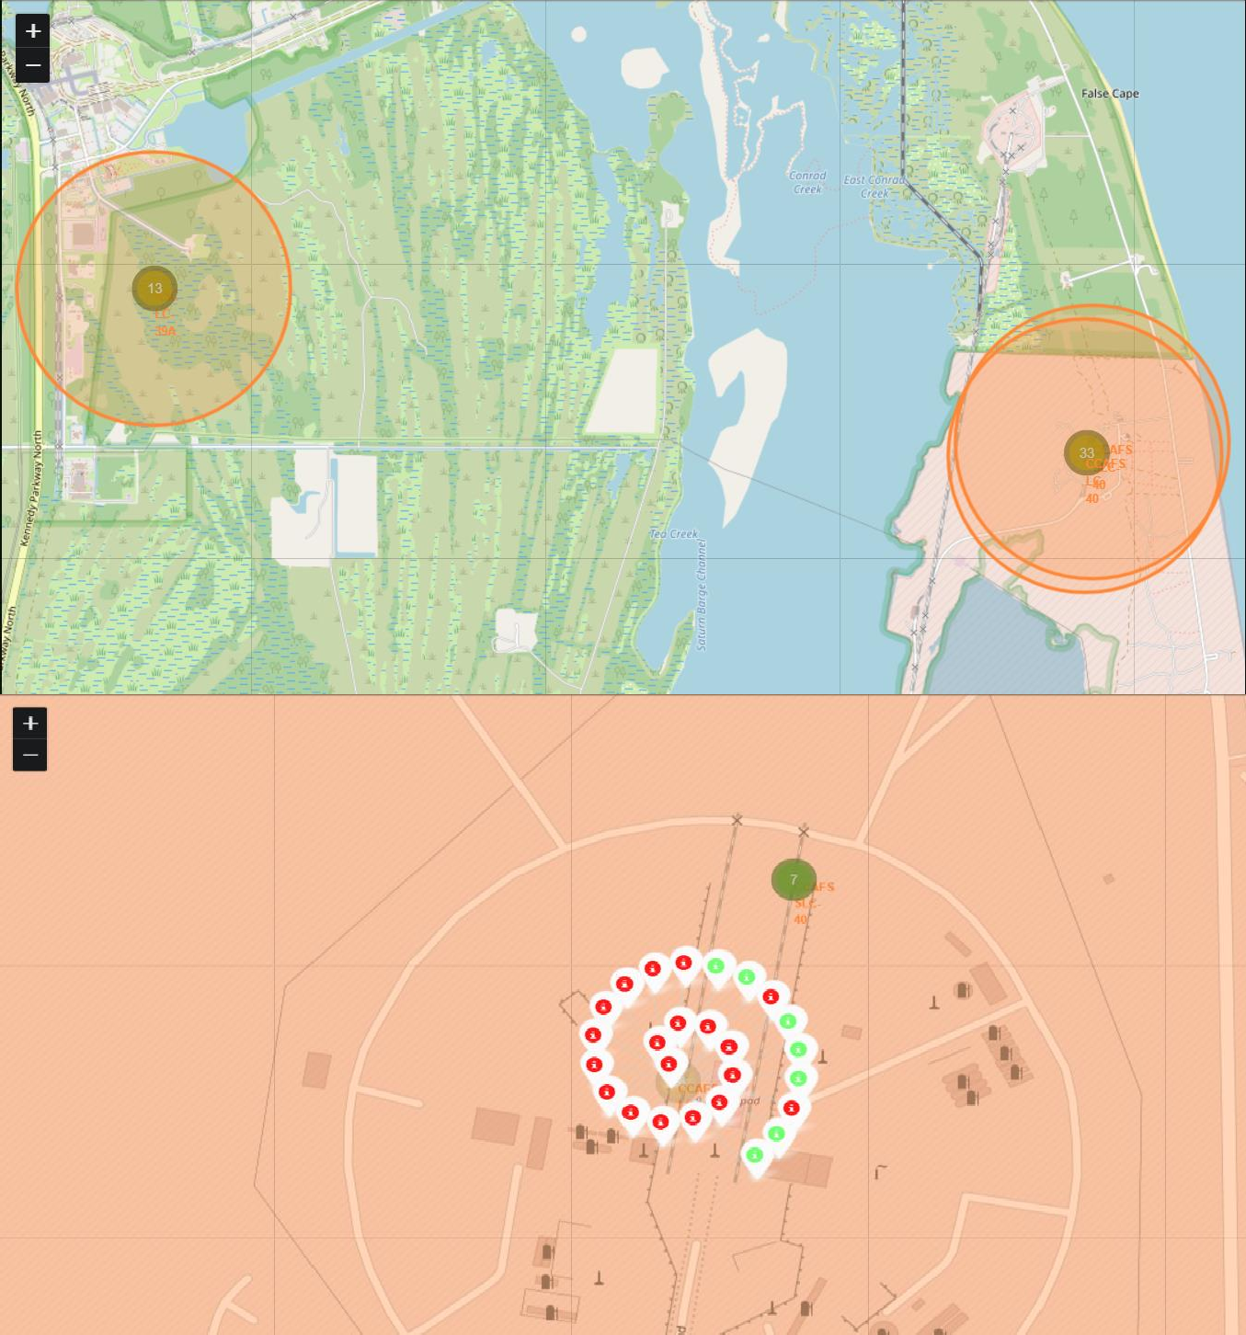
Task 2: Mark the success/failed launches for each site on the map
This enhanced visualization with clustered markers allows for better exploration and analysis of SpaceX launch data. The clustering makes it easier to manage a large number of markers and observe patterns that might be hidden in a less organized plot. By examining the marker colors and popup information, you can gain deeper insights into the characteristics and distribution of SpaceX launches.
For example, in the provided screenshot, out of 26 launch sites for CCAFS LC-40, there are 19 red markers and 7 green markers. This color-coding helps to quickly identify the success rate and other categorical distinctions of the launches from this specific site. The red markers might represent unsuccessful launches, while the green markers indicate successful ones, providing immediate visual feedback on the performance of launches at each site.
42

Slide 43
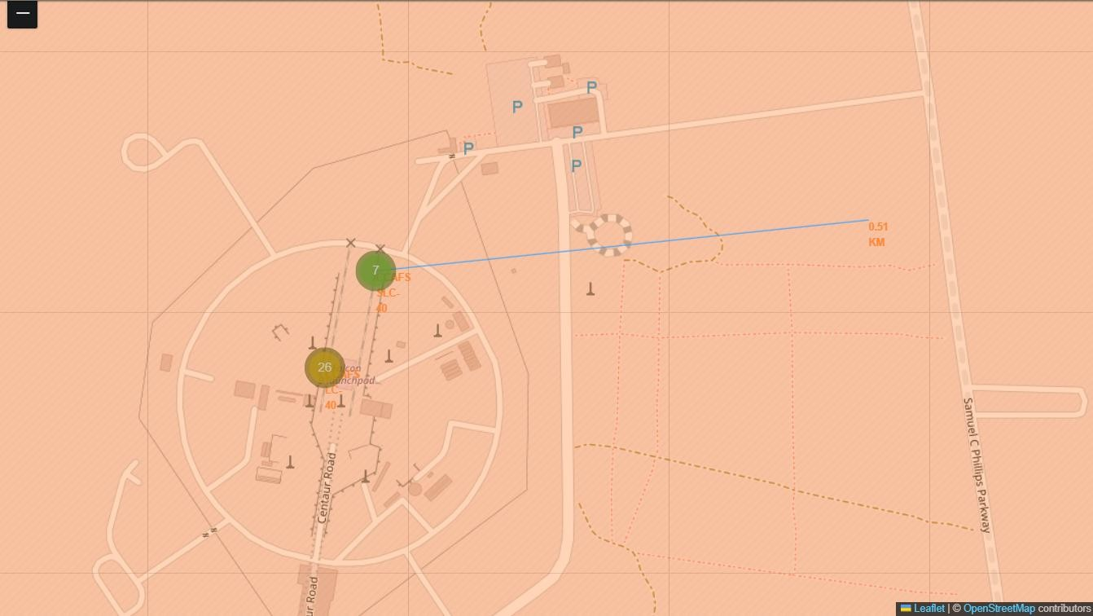
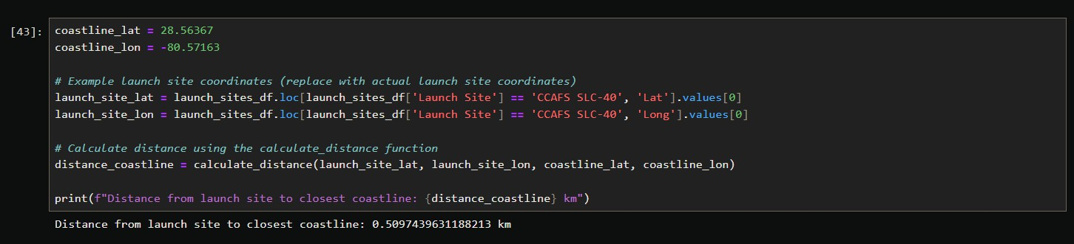
Task 3: Calculate the distances between a launch site to its proximities
This plot provides a visual representation of the distance between the CCAFS SLC-40 launch site and the closest coastline. The calculated distance is approximately 0.51 kilometers, as indicated by the marker. The added PolyLine clearly shows the straight-line distance, highlighting the proximity of the launch site to the coast. This close proximity to the coastline is typical for launch sites to facilitate over-water flight paths and safe recovery operations, ensuring minimal risk to populated areas.
43

Slide 44

Section 4

Slide 45
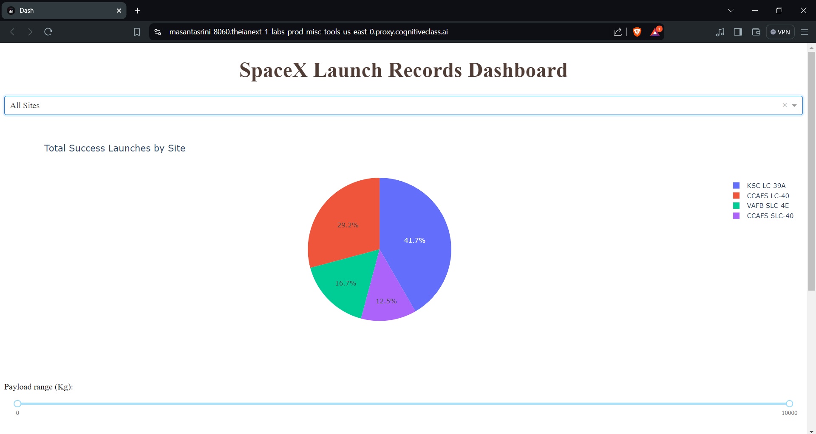
Launch Success Count for all sites (in a pie chart)
Key Findings:
CCAFS LC-40: 29.2%
CCAFS SLC-40: 12.5%
VAFB SLC-4E: 16.7%
KSC LC-39A: 41.7%
The KSC LC-39A launch site has the highest number of successful launches, making up 41.7% of the total
successes. This indicates that KSC LC-39A is a highly reliable site for SpaceX launches.
45

Slide 46
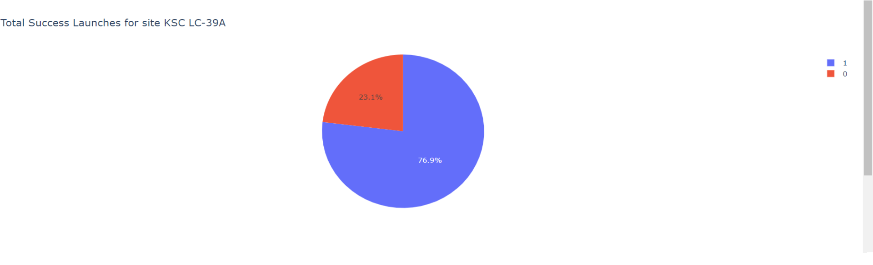
Pie chart for the launch site with highest launch success ratio
Key Findings:
The significant portion of successful launches from KSC LC-39A highlights its reliability and effectiveness as a launch site.
For KSC LC-39A:
Class 1 (Successful Launches): 76.9%
Class 0 (Unsuccessful Launches): 23.1%
The high success rate (76.9%) for Class 1 launches underscores the effectiveness and
reliability of the KSC LC-39A site.
46

Slide 47
Key Insights from SpaceX Launch Data Dashboard
Launch Site Success Rates:
CCAFS LC-40 has the highest success rate with 43.7% of successful launches.
This suggests that CCAFS LC-40 is the most reliable launch site among the ones analyzed.
Other sites like KSC LC-39A, VAFB SLC- 4E, and CCAFS SLC-40 have lower success rates, indicating variability in launch success across different sites.
Booster Version Performance:
Booster version “FT” appears to be the most frequently used and has a high success rate across various payload masses.
Booster version “v1.0” has fewer launches and may require further analysis to understand its performance.
Overall, booster versions do not show a clear trend that higher payload masses correlate with lower success rates.
47

Slide 48

Section 5

Slide 49
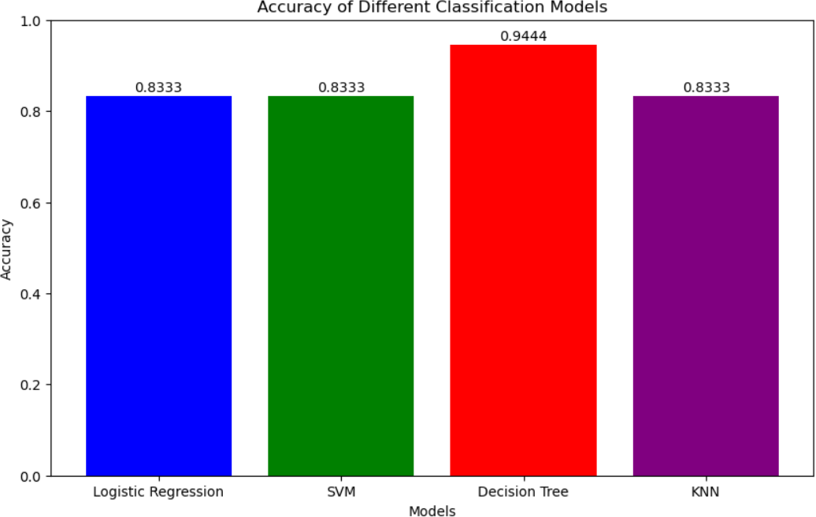
Classification Accuracy
Based on the results, the Decision Tree model has the highest classification accuracy on the test data, achieving an accuracy of 0.9444. This suggests that the Decision Tree model is better suited for this dataset compared to Logistic Regression, Support Vector Machine, and K Nearest Neighbors, all of which achieved an accuracy of 0.8333.
49

Slide 50
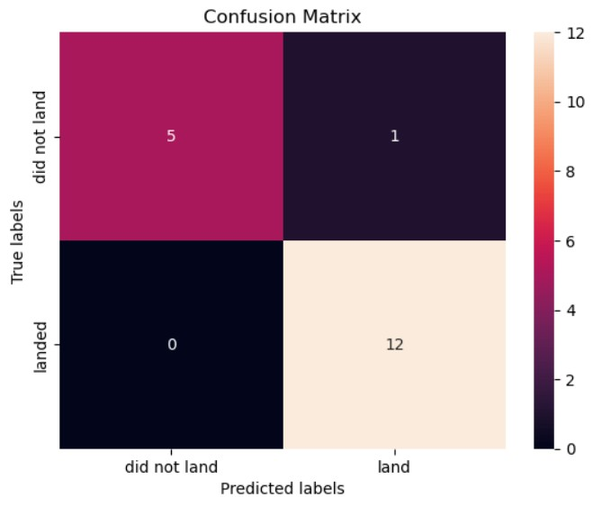
Confusion Matrix
Explanation and Insights
High Accuracy: The model achieved a high accuracy score of 94.44%, with a significant number of true positives and true negatives, demonstrating its effectiveness in predicting Falcon 9 first stage landings.
No False Negatives: The absence of false negatives indicates that the model reliably predicts successful landings. This is crucial for ensuring readiness and safety in aerospace operations, as every actual successful landing was accurately identified.
Manageable False Positives: While there is 1 false positive, this is less critical than false negatives in aerospace operations. Over- preparation (due to false positives) is more manageable than under-preparation, making the model's performance highly acceptable for practical applications.
Balanced Performance: The model shows a balanced performance with a slight bias towards predicting successful landings. This aligns well with practical needs in the aerospace industry, where ensuring successful landings is of paramount importance for cost estimation and planning.
50

Slide 51
Conclusions
Point 1: Our analysis revealed that the "CCAFS LC-40" launch site has the highest success rate among all sites, accounting for 43.7% of successful launches. This indicates that this site might have optimal conditions or processes that contribute to a higher success rate.
Point 2: The scatter plot analysis showed that the "FT" booster version has a high success rate across various payload masses, demonstrating its reliability and robustness compared to other booster versions. This suggests that future missions might benefit from utilizing this booster version for improved success rates.
Point 3: No clear pattern was observed linking higher payload masses to lower success rates, indicating that factors other than payload mass, such as launch site conditions and booster versions, play a more significant role in determining the outcome of a launch.

Slide 52
Conclusions
Point 4: Interactive data visualizations using Folium and Plotly Dash provided valuable insights into the geographical and operational patterns of SpaceX launches. These tools allowed for a deeper understanding of the data, enabling stakeholders to make informed decisions based on comprehensive visual analytics.
In conclusion, our predictive analysis and interactive visualizations have not only shed light on key factors influencing SpaceX's launch success but also provided a robust framework for future assessments and decision-making in the aerospace industry. The insights gathered can help improve launch strategies and contribute to the ongoing success of reusable rocket technology.

Slide 53


